Slide 1
Data representation
CAOS 2019

Slide 2
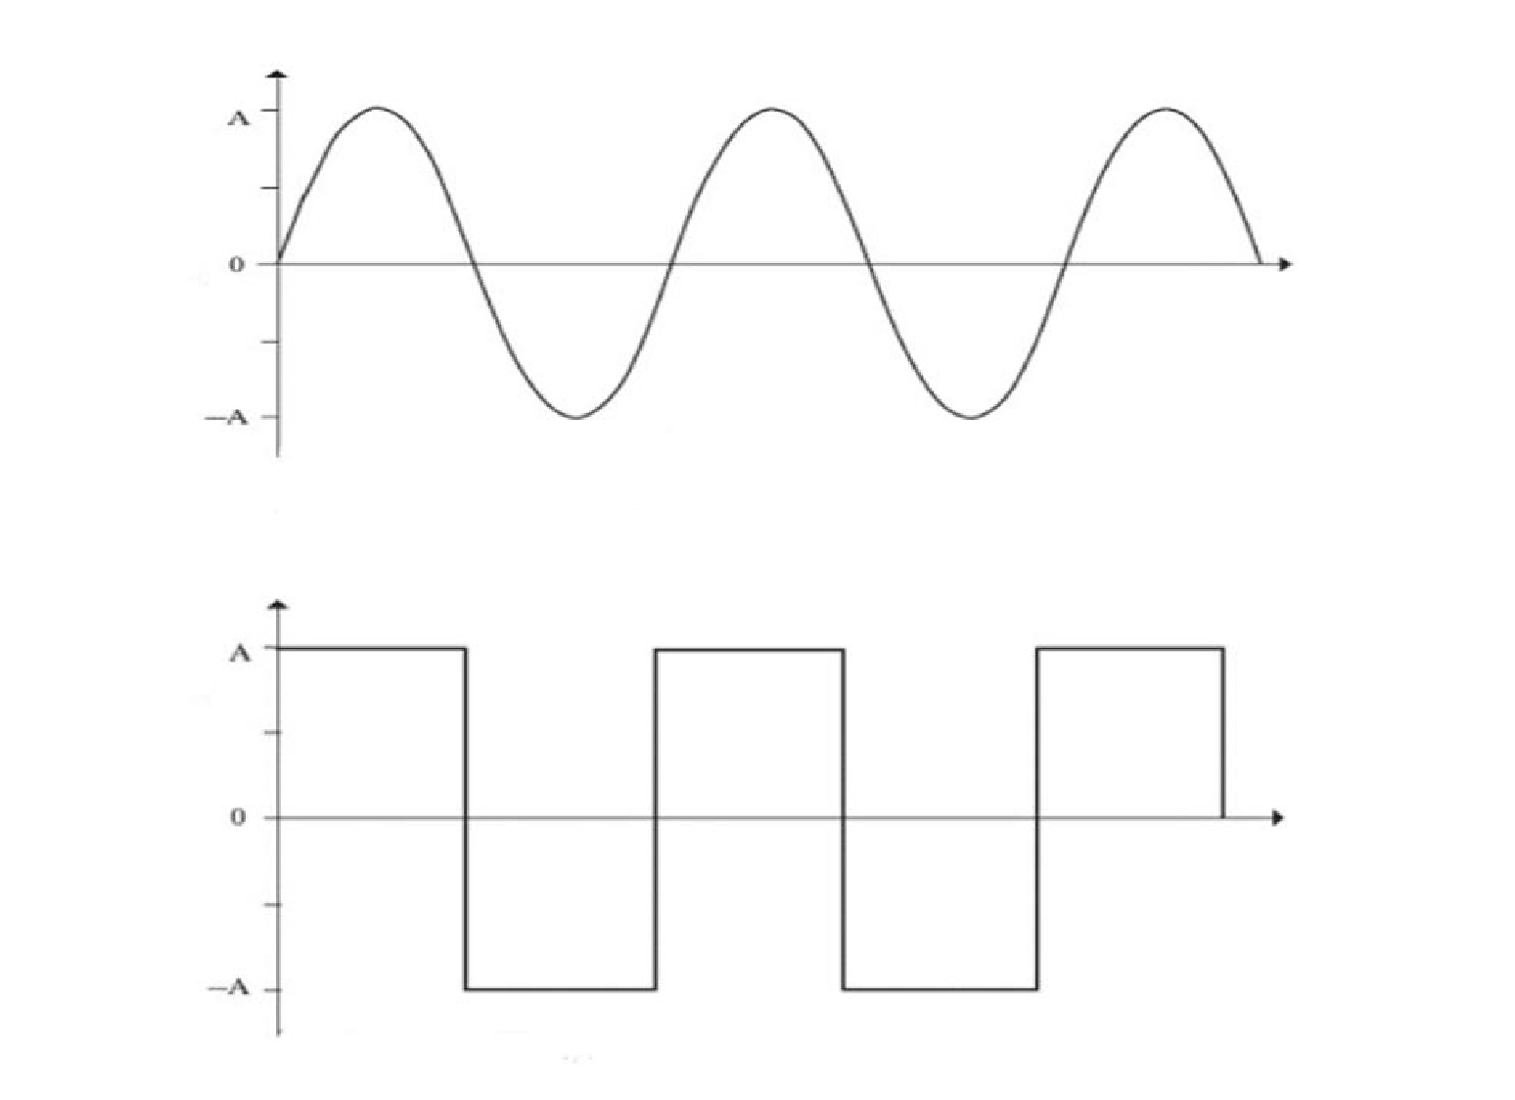
Analog signal -> Digital signal

Slide 3
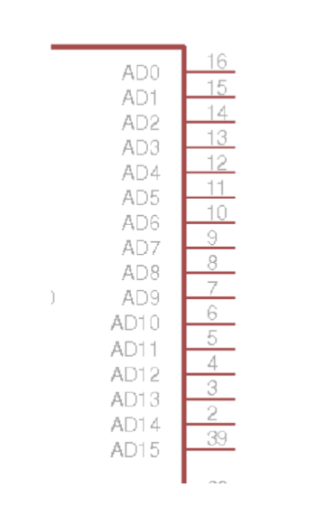
Inputs/Outputs states
“0” – voltage < threshold_0 (~0.7 V)
“1” – voltage > threshold_1 (~2 V)
Undefined
High impedance

Slide 4
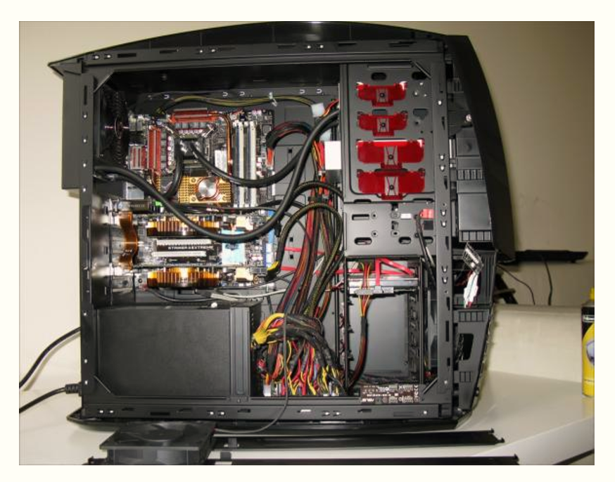
PC organization

Slide 5
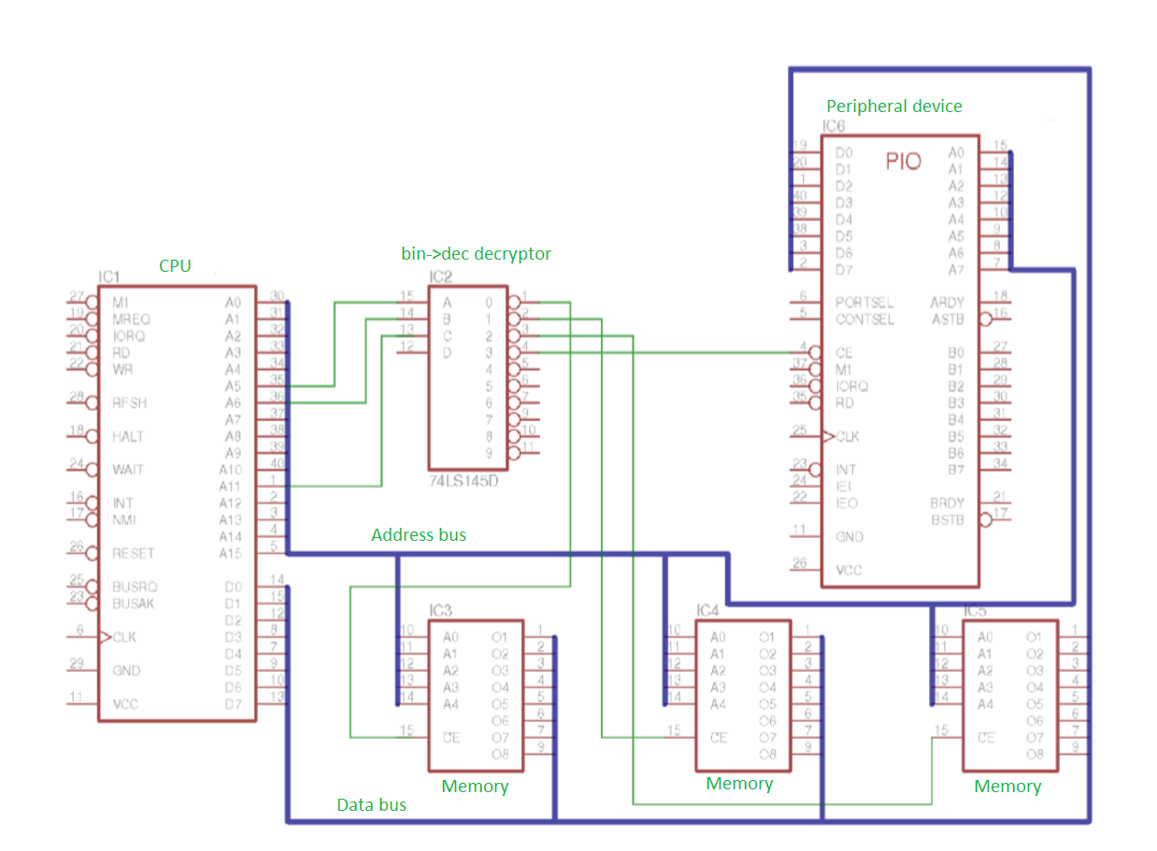
Intel 8080

Slide 6
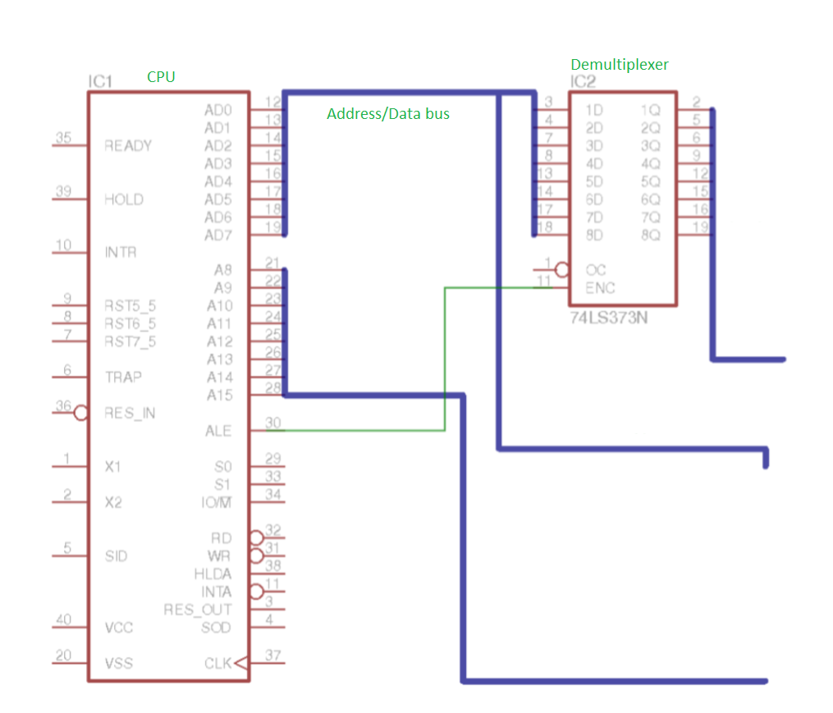
Intel 8085

Slide 7
System architecture
Von Neumann architecture – same address space for instructions and data (Almost every processor)
Harvard architecture – separate address space for instructions and data (microcontrollers)
Modified Harvard architecture – less separated memory, but still concurrent buses

Slide 8
Data encoding
1 byte – minimal addressable memory unit
CPU can read 1 machine word per clock tick
Bit order depends on processor
Byte order (inside a word) also depends on processor

Slide 9
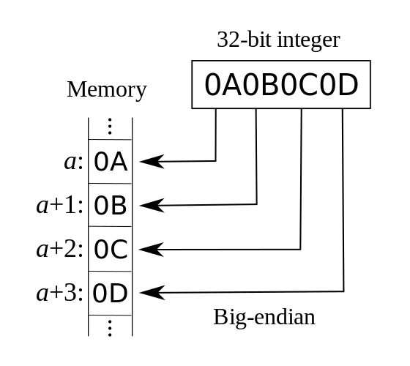
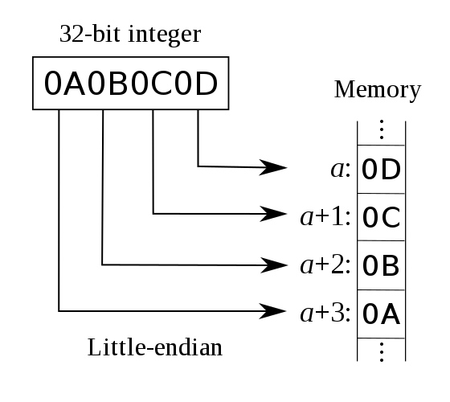
BE vs LE
BigEndian – natural order of bytes: most significant bytes first. (Standard for networking)
LittleEndian – byte order in x86: less significant bytes first. Common for x86

Slide 10
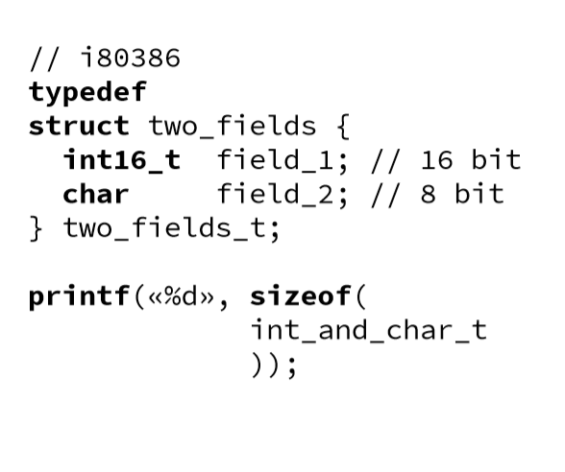
Structs alignment
Blocks that have lengths divisible to machine word length are more convenient for CPU
Fields in structs (and classes) aligned to borders

Slide 11
Data representation
Unsigned integers
Signed integers – no standard in C, however most processor use two’s complement

Slide 12
Unsigned | Binary | Direct encoding | Complement encoding
0 | 000 | 0 | 0
1 | 001 | 1 | 1
2 | 010 | 2 | 2
3 | 011 | 3 | 3
4 | 100 | -0 | -4
5 | 101 | -1 | -3
6 | 110 | -2 | -2
7 | 111 | -3 | -1

Slide 13
Integer oveflow
X + Y – sum(X, Y) =: C > 0 -overflow
C = 0 iff sum(X, Y) > X && sum(X, Y) > Y
CPU can catch overflow (OF)
However C can’t check it explicitly

Slide 14
String representation
ASCII – 7 bit for Latin
[128, 255] for national characters
Universal UTF8 encoding with variable code length
2 or 4 bytes per symbol

Slide 15
man 7 utf8
0x00000000 - 0x0000007F: 0xxxxxxx
0x00000080 - 0x000007FF: 110xxxxx 10xxxxxx
0x00000800 - 0x0000FFFF: 1110xxxx 10xxxxxx 10xxxxxx
0x00010000 - 0x001FFFFF: 11110xxx 10xxxxxx 10xxxxxx 10xxxxxx
0x00200000 - 0x03FFFFFF: 111110xx 10xxxxxx 10xxxxxx 10xxxxxx 10xxxxxx
0x04000000 - 0x7FFFFFFF: 1111110x 10xxxxxx 10xxxxxx 10xxxxxx 10xxxxxx 10xxxxxx

Slide 16
wchar_t
sizeof(wchar_t)==4 (Unix) or 2 (MSVC)
wchar_t usage guarantees correct [] indexing
Utf8 is good only for sequential processing

Slide 17
Float representation (IEEE 754)

